Slide 1


Slide 2
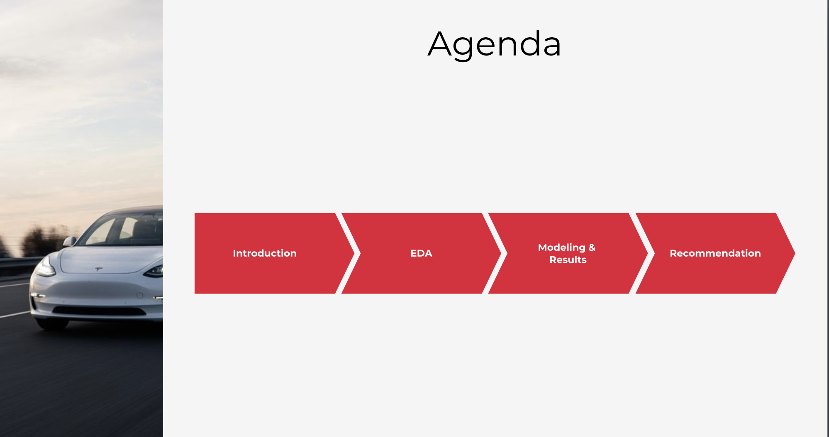



Agenda
Agenda
Introduction
Modeling
& Results
EDA
Recommendation

Slide 3
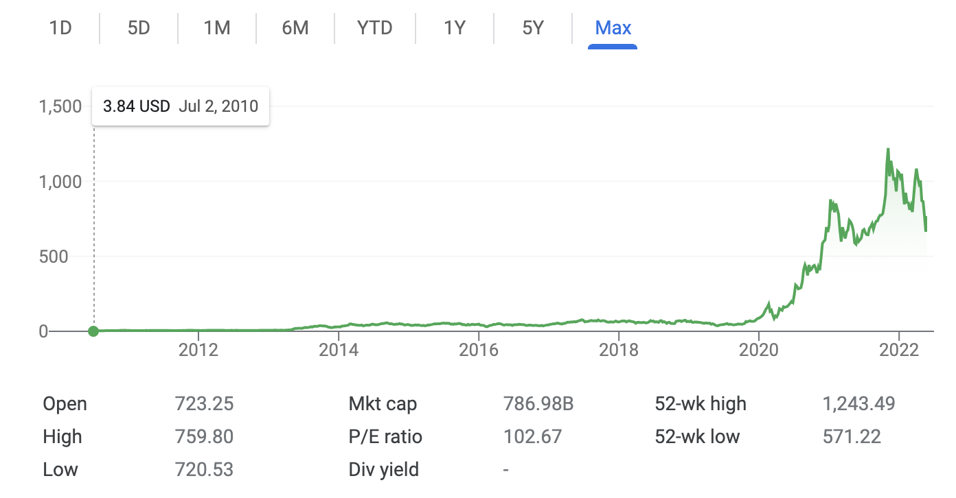
Introduction
EDA
Modeling & Results
Recommendation
Founded in 2003 by Elon Musk, Martin Eberhard, and Marc Tarpenning
Jan 2010, Tesla Registers for an IPO
Tesla, Inc. | 2
Notes:
we all know tesla was founded by Elon Musk, and after 7 testing years, it opened its door to the public.
on the bottom you can see the price movement ans the kind of return it has generated for its shareholders- from listing at 3$ to a high of $760 - thats a compounded return of 55% YoY

Slide 4
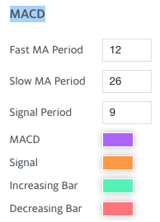
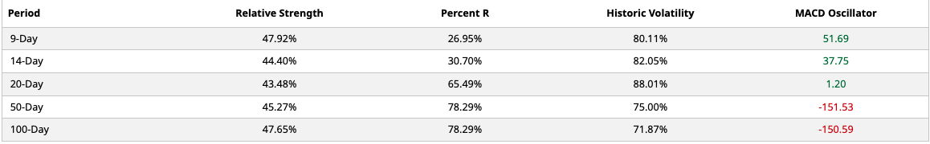
Introduction
EDA
Modeling & Results
Recommendation
High historical volatility
Stock prices affected by various factors
Tesla, Inc. | 2
Notes:
we chose tesla as its share price volatility is quite high due to its founder Musk who tweets- represents the percent change in share price
Another way to measure volatility is by computing the standard deviation of these percent changes. A larger standard deviation corresponds to higher volatility
MACD crossing above zero is considered bullish, while crossing below zero is bearish.
When the MACD line crosses from below to above the signal line, the indicator is considered bullish. The further above/ below the zero line the stronger the signal

Slide 5
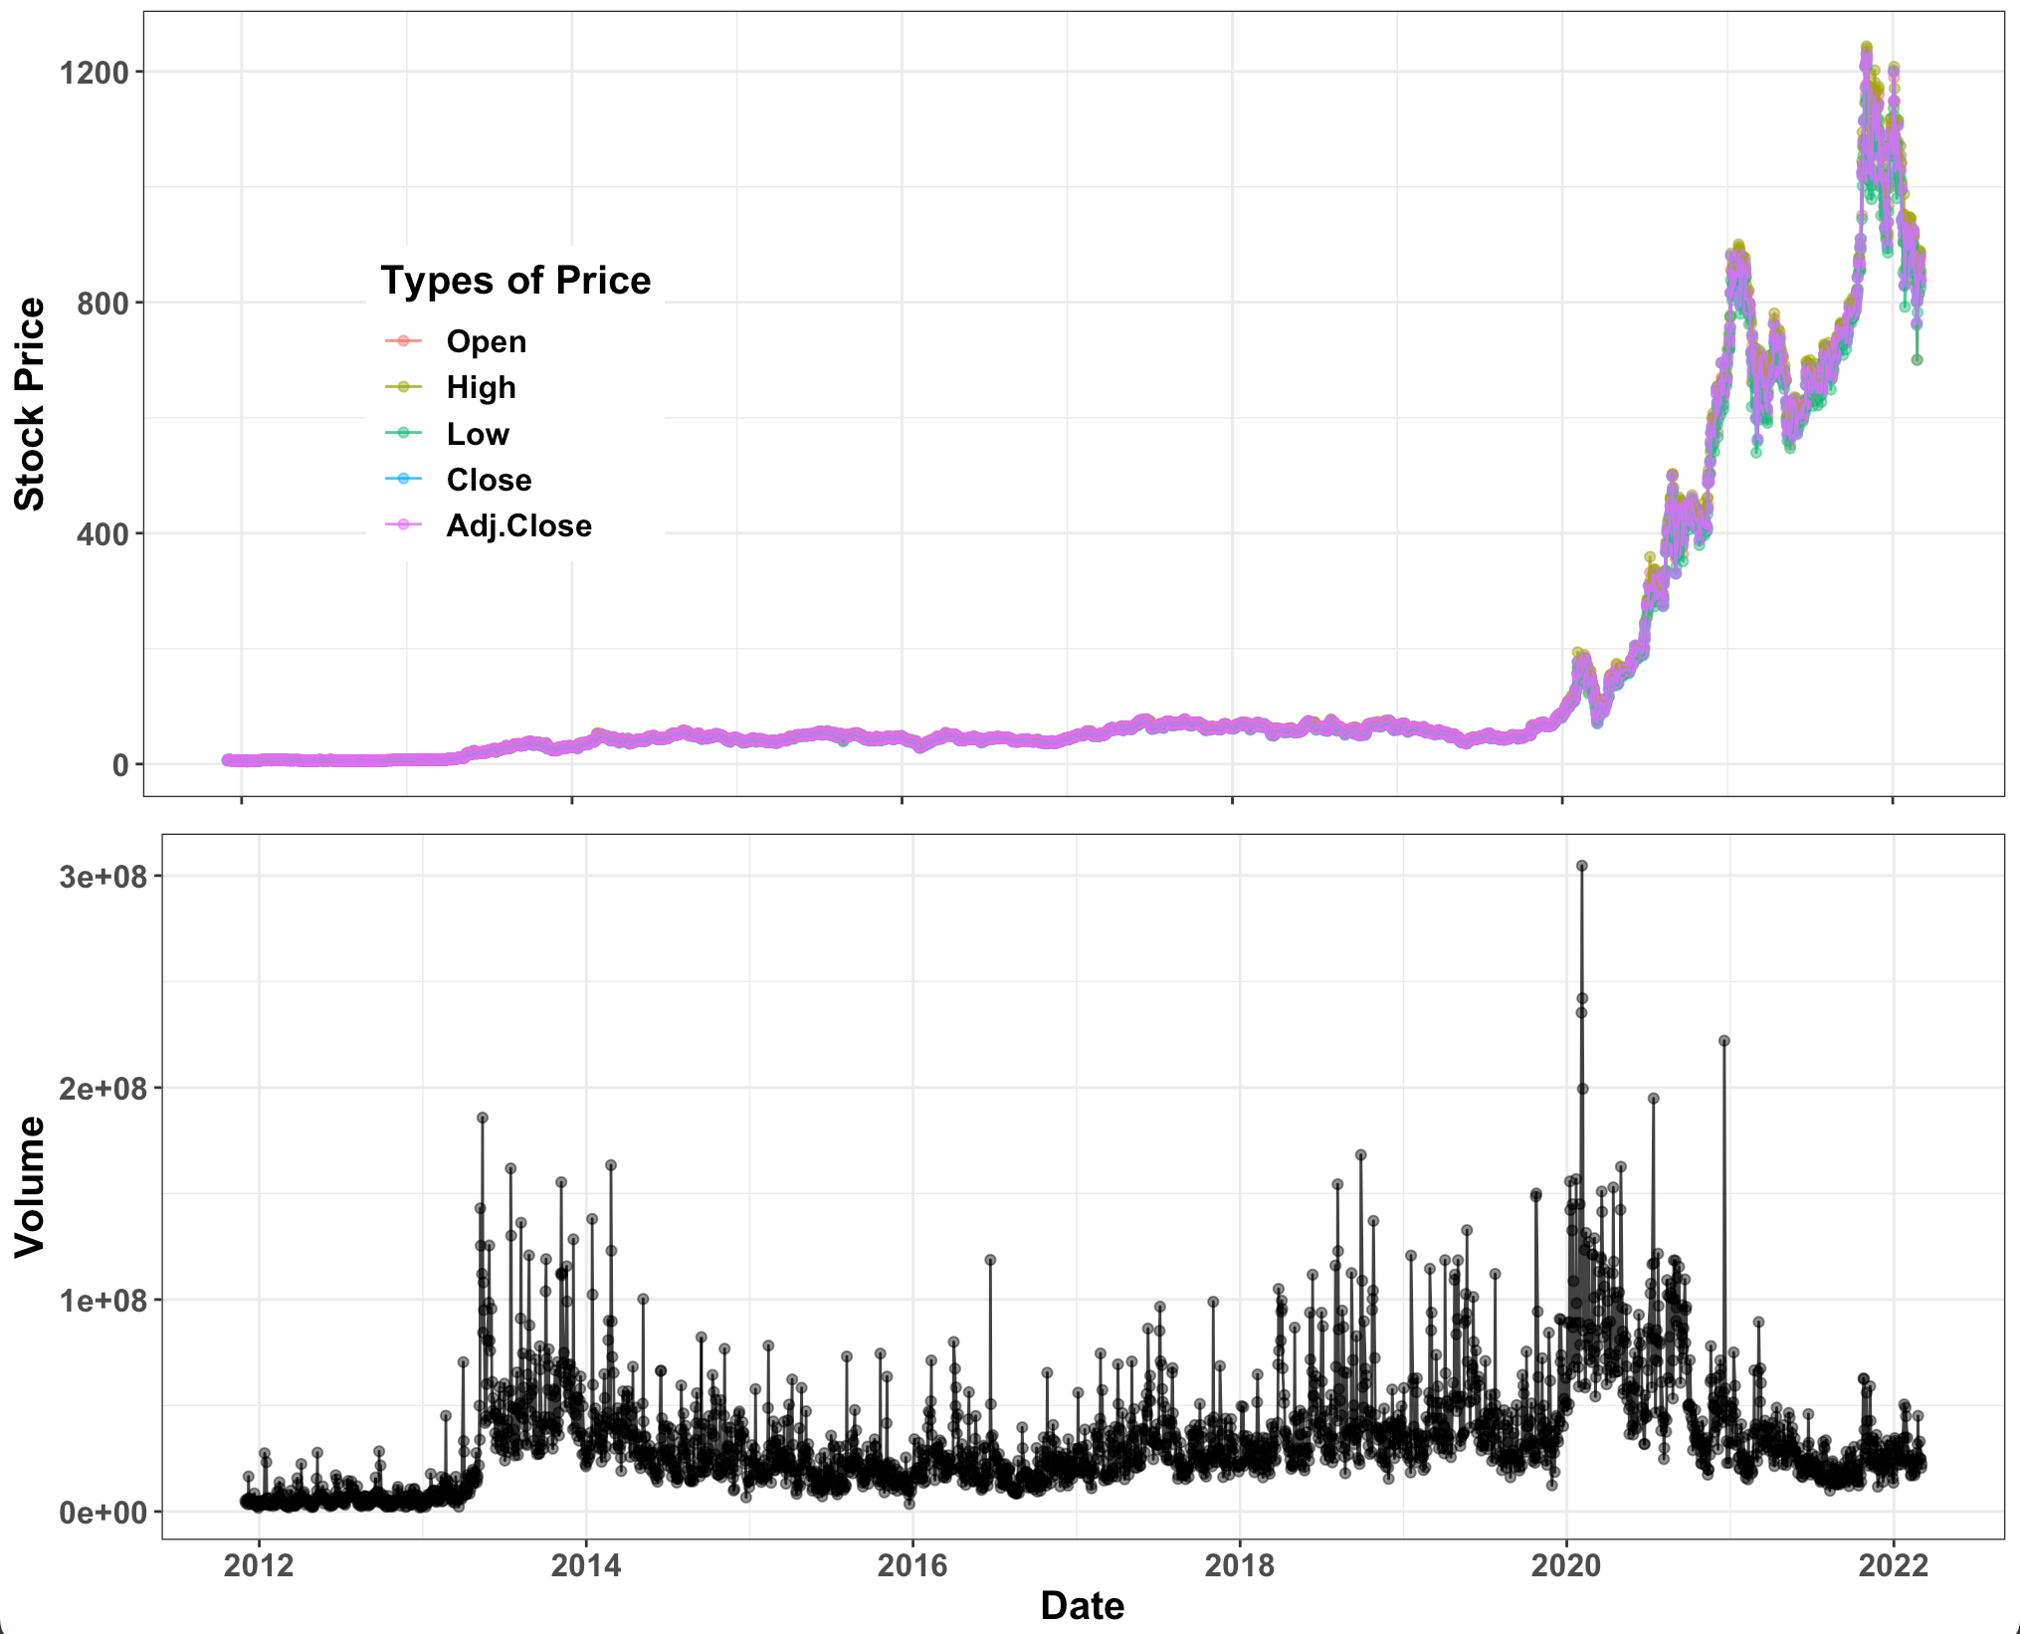
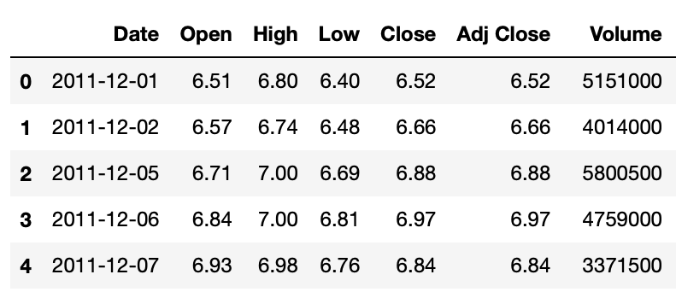
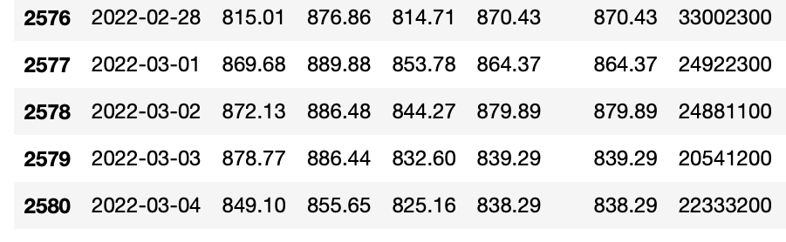
Introduction
EDA
Modeling & Results
Recommendation
Source: TESLA Stock Price, Yahoo Finance
Data Shape: (2581, 8)
Time: 2011-12-01 ~ 2022-3-4
Tesla, Inc. | 3
Notes:
EDA: of the 5 variables- we used the daily closing price for our analysis
on the right is a screenshot of the data- which we sourced from yahoo finance
and we limited our dataset to Dec 2011, as we wanted to combine it with Elon Musks Tweets Data - which will be covered later

Slide 6
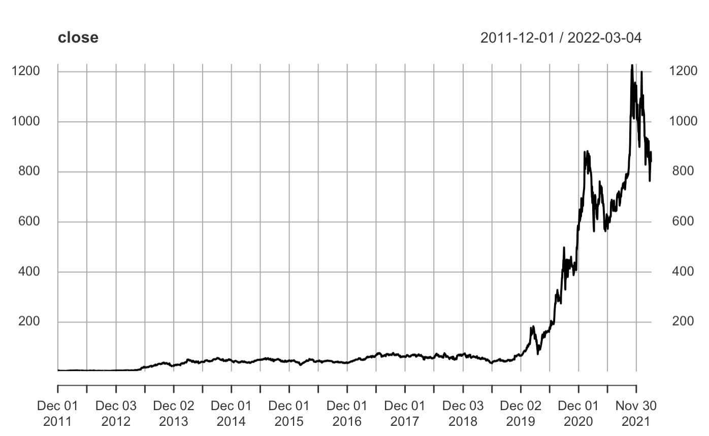
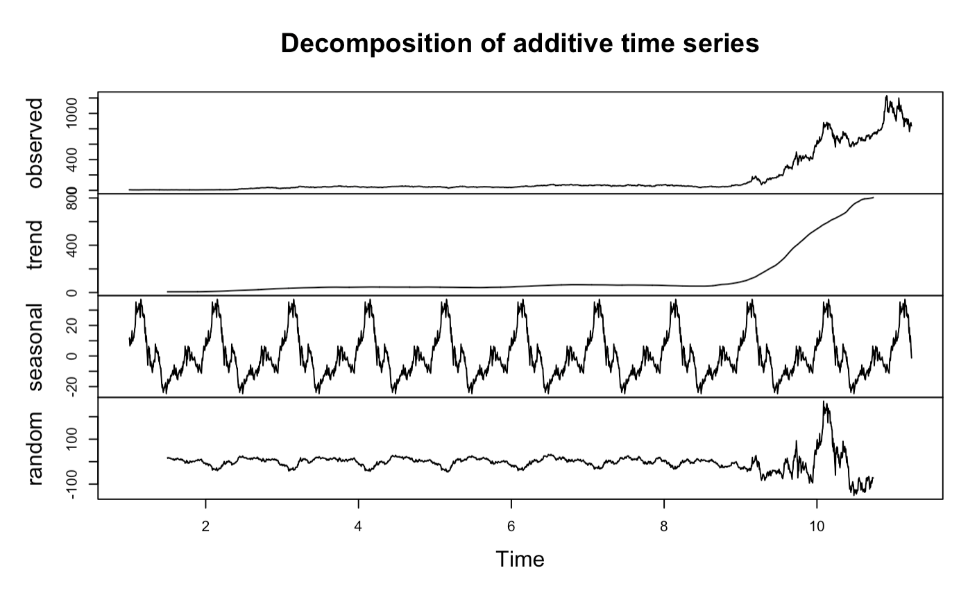
Introduction
EDA
Modeling & Results
Recommendation
Steady Trend 2011-12 ~ 2019-12
Positive Trend 2020-1 ~ Present
COVID Starts from March 2020
Additive Seasonality
Tesla, Inc. | 3
Notes:
EDA: closing price - steady for almost 8 years and last 2 years significant upwards trend, around the COVID time
Closing price has additive seasonality
there is some randomness as time progresses

Slide 7
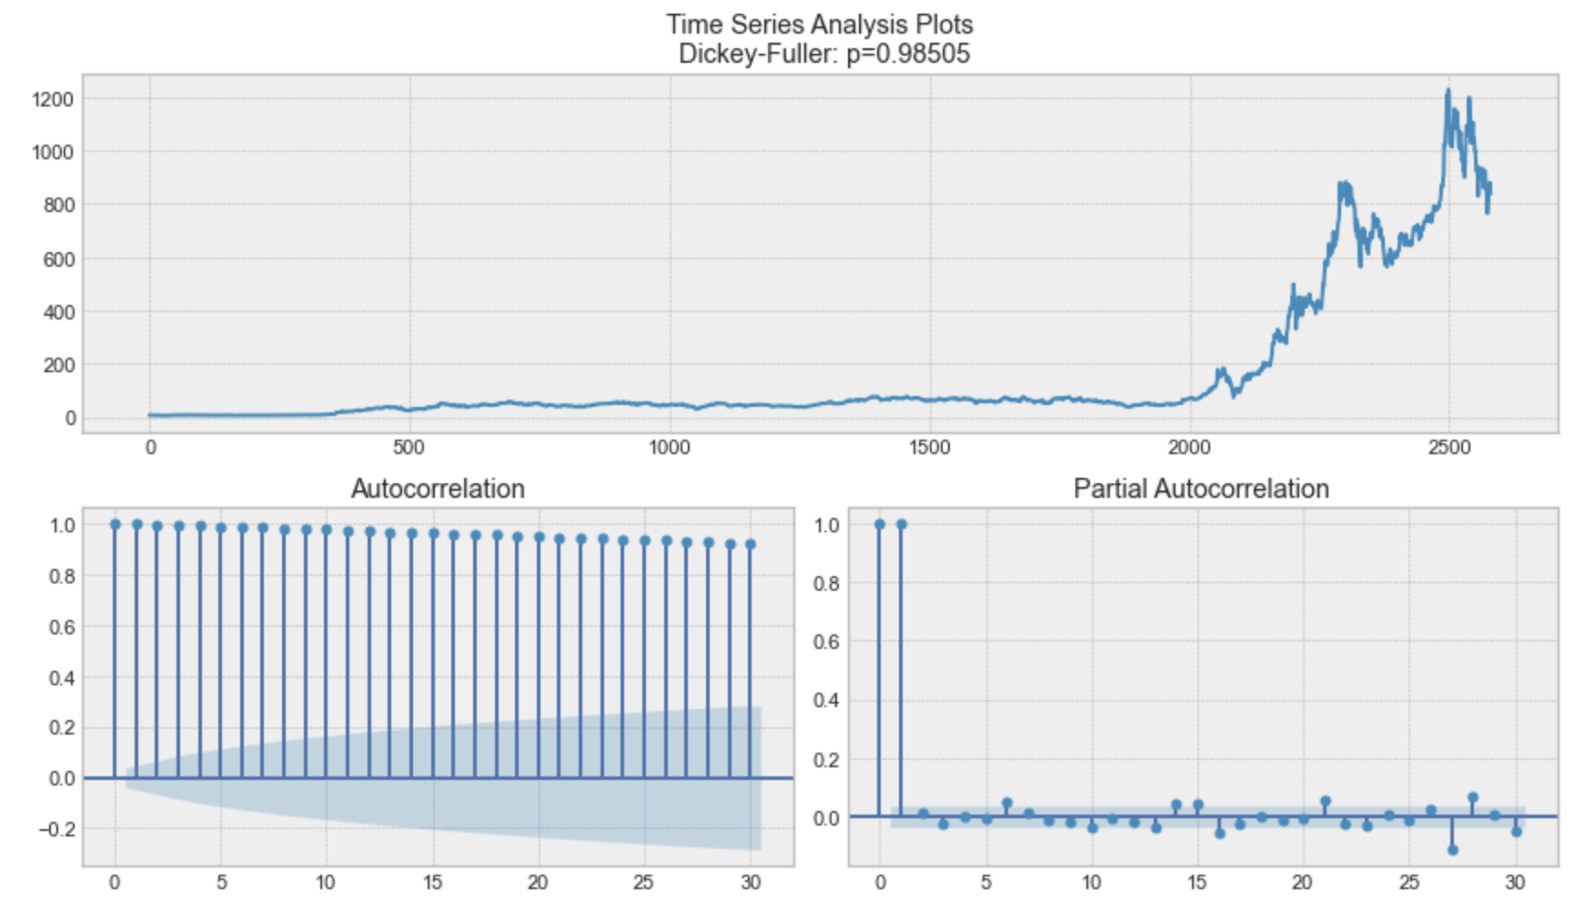
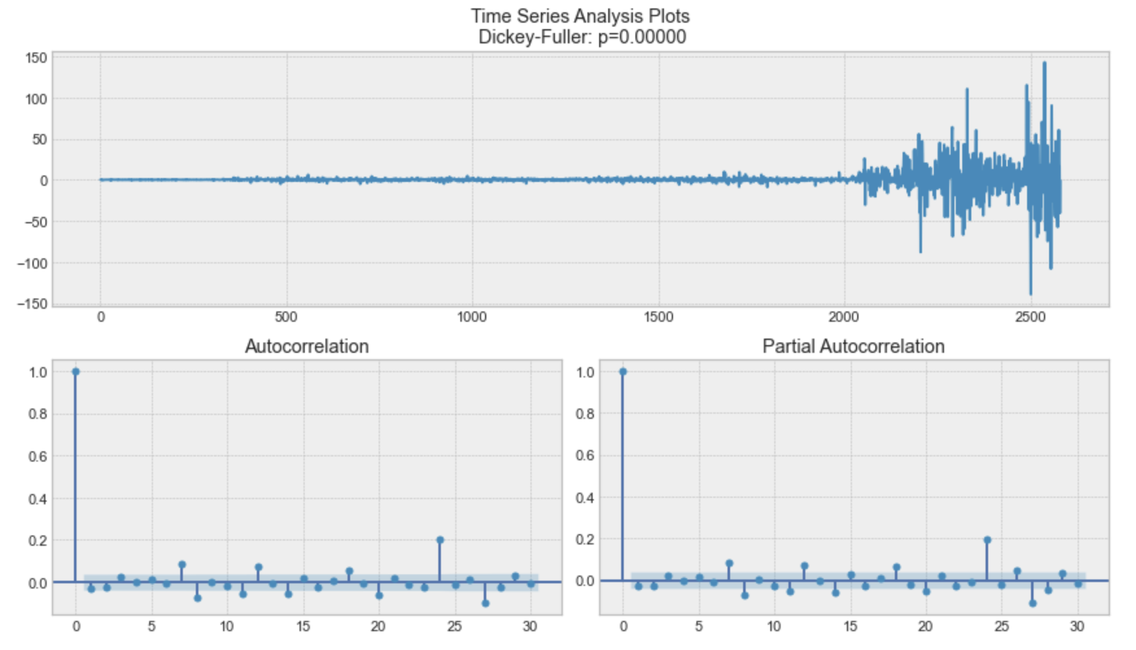
Introduction
EDA
Modeling & Results
Recommendation
ACF & PACF
ACF of Closing Price Non-Stationary
ACF of Closing Price (lag =1)
Stationary
Tesla, Inc. | 6
Notes:
EDA: ACF of first and second moments, frequency analysis, seasonality analysis f1-f4 (tsfeatures)
The ACF plot confirms that the time series is non-stationary,as all the lag values are significant and go above the blue dotted line
high autocorrelation originally, after differentiating once, we can see ACF is not significant in value

Slide 8
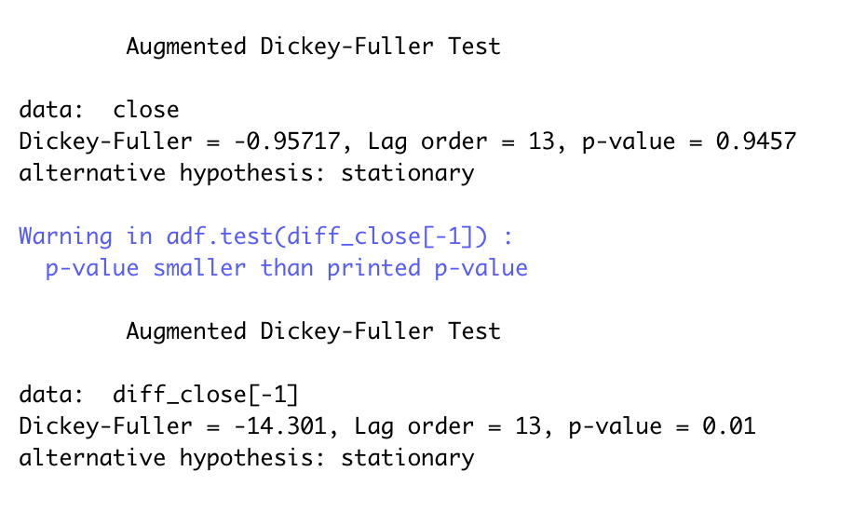
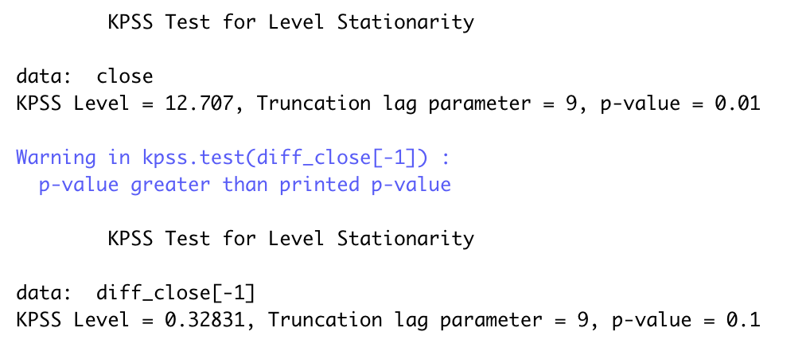

Introduction
EDA
Modeling & Results
Recommendation
ADF & KPSS Test
ADF Test Results
adf.test(close)
diff_close<-diff(close)
adf.test(diff_close[-1])
KPSS Test Results
kpss.test(close)
diff_close<-diff(close)
kpss.test(diff_close[-1])]
Tesla, Inc. | 8
Notes:
The null hypothesis for ADF test is that the time series is non-stationary. Since the p-value is greater than 0.05, hence, we don’t reject the null hypothesis and thus TS is non- stationary.
Likewise, for the KPSS since the p-value is less than 0.05, hence, we reject the null hypothesis that the TS is stationary, and conclude that the TS is non- stationary.
after doing the first differentiation, we see the opposite and can conclude that the TS is now stationary

Slide 9
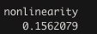
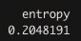
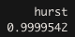
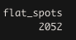
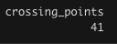
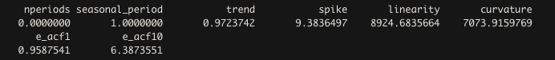
Introduction
EDA
Modeling & Results
Recommendation
TS Features
Other tests
stl_features(df_num)
nonlinearity(df_num)
flat_spots(df_num)
crossing_points(df_num)
TS Features
install.packages("tsfeatures")
library("tsfeatures")
tsfeatures(df_num)
entropy(df_num)
hurst(df_num)
Entropy: forecastable
Nonlinearity: linear
Hurst: Long term memory
Flat spots & Crossing Points
STL
Tesla, Inc. | 8
Notes:
Now that we covered the stationarity of the TS, that also refers to the residual value of the TS, we use the TS Features package, to check a few other characteristics such as entropy, hurst stl
entropy- This measures the “forecastability” of a time series, where low values indicate a high signal-to-noise ratio, and large values occur when a series is difficult to forecast.
Hurst gives an idea if the TS is a long memory or not- if value is less than 0.5
stl_features Computes various measures of trend and seasonality of a time series based on an STL decomposition. The mstl function is used to do the decomposition.
nonlinearlity- This takes large values when the series is nonlinear, and values around 0 when the series is linear.
crossing points are defined as the number of times a time series crosses the median line.
flat_spots are computed by dividing the sample space of a time series into ten equal-sized intervals, and computing the maximum run length within any single interval.

Slide 10
Introduction
EDA
Modeling & Results
Recommendation
Model Selection for Univariate and Multivariate TS
Naïve
Exponential Smoothing (ETS)
Holt-Trend
GARCH
Prophet Curve Fitting Model
Prophet Curve Fitting Model
Tesla, Inc. | 10

Slide 11

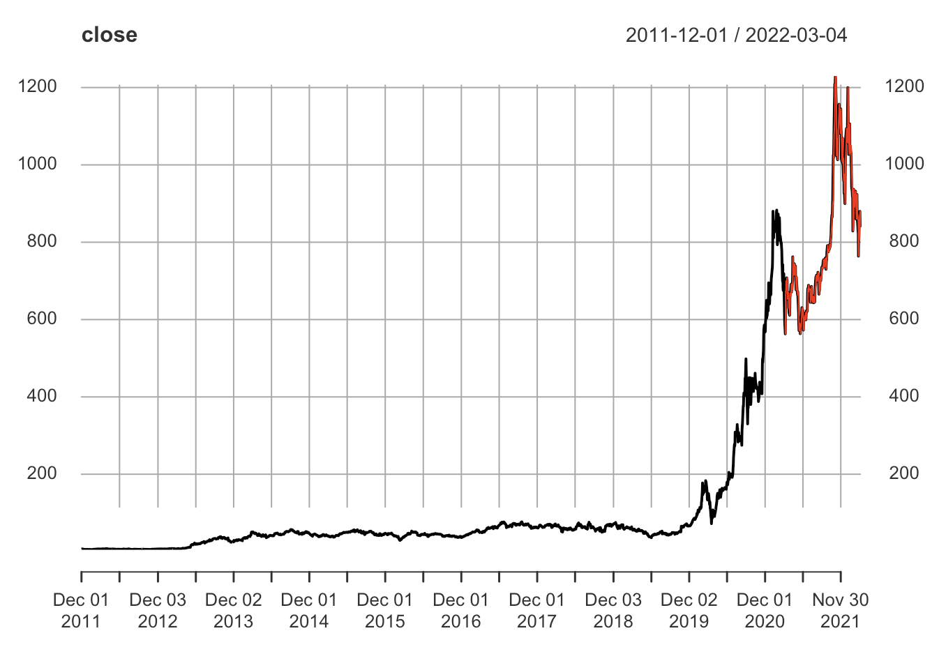
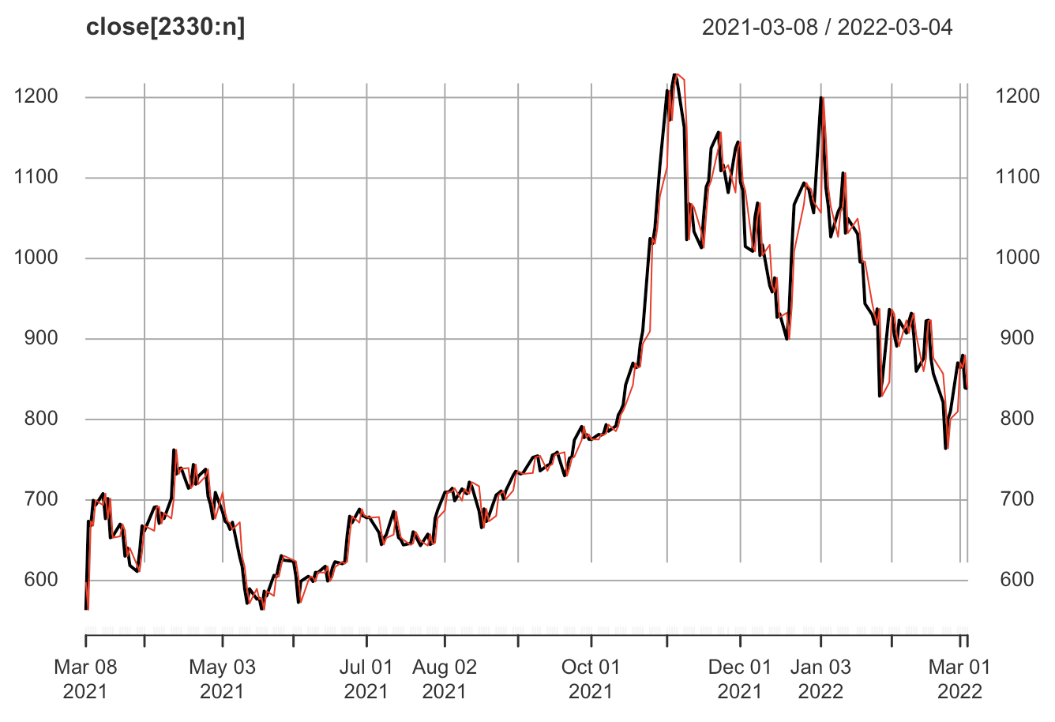
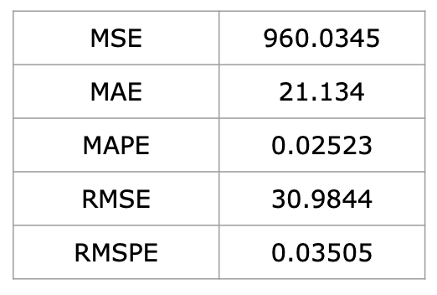
Introduction
EDA
Modeling & Results
Recommendation
Naïve Model
zoom in
Actual
Predict
2.52%
Tesla, Inc. | 12

Slide 12
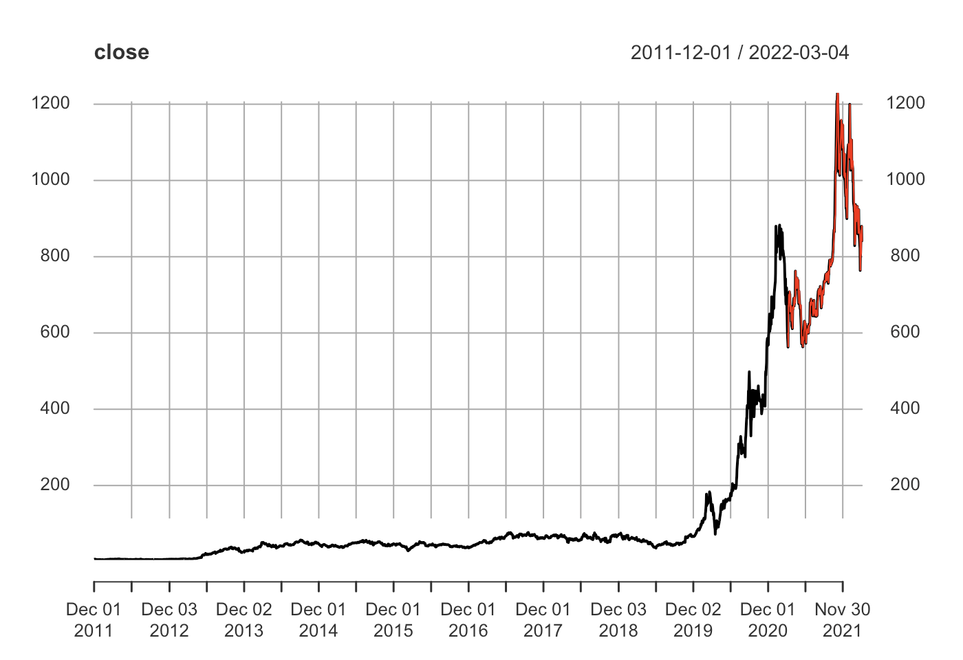
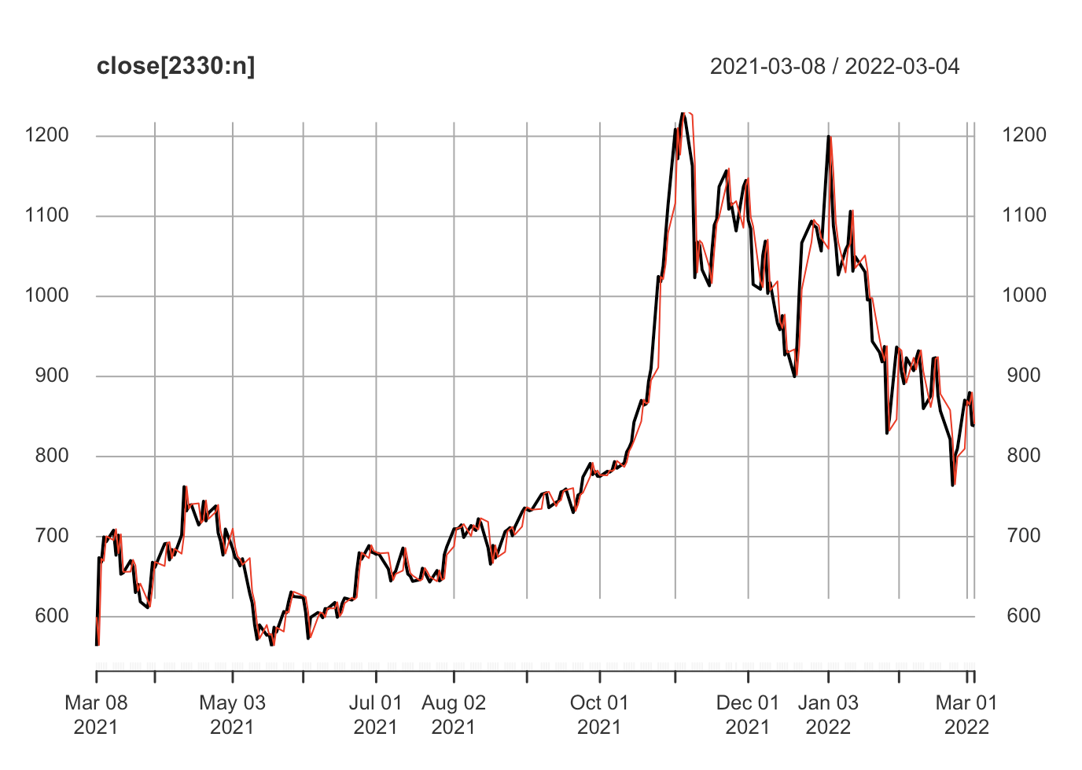
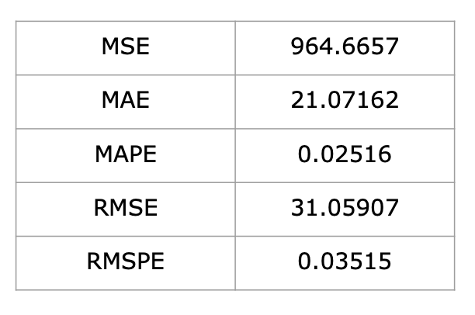
Introduction
EDA
Modeling & Results
Recommendation
Exponential Smoothing (ETS)
zoom in
Actual
Predict
2.51%
Tesla, Inc. | 12

Slide 13
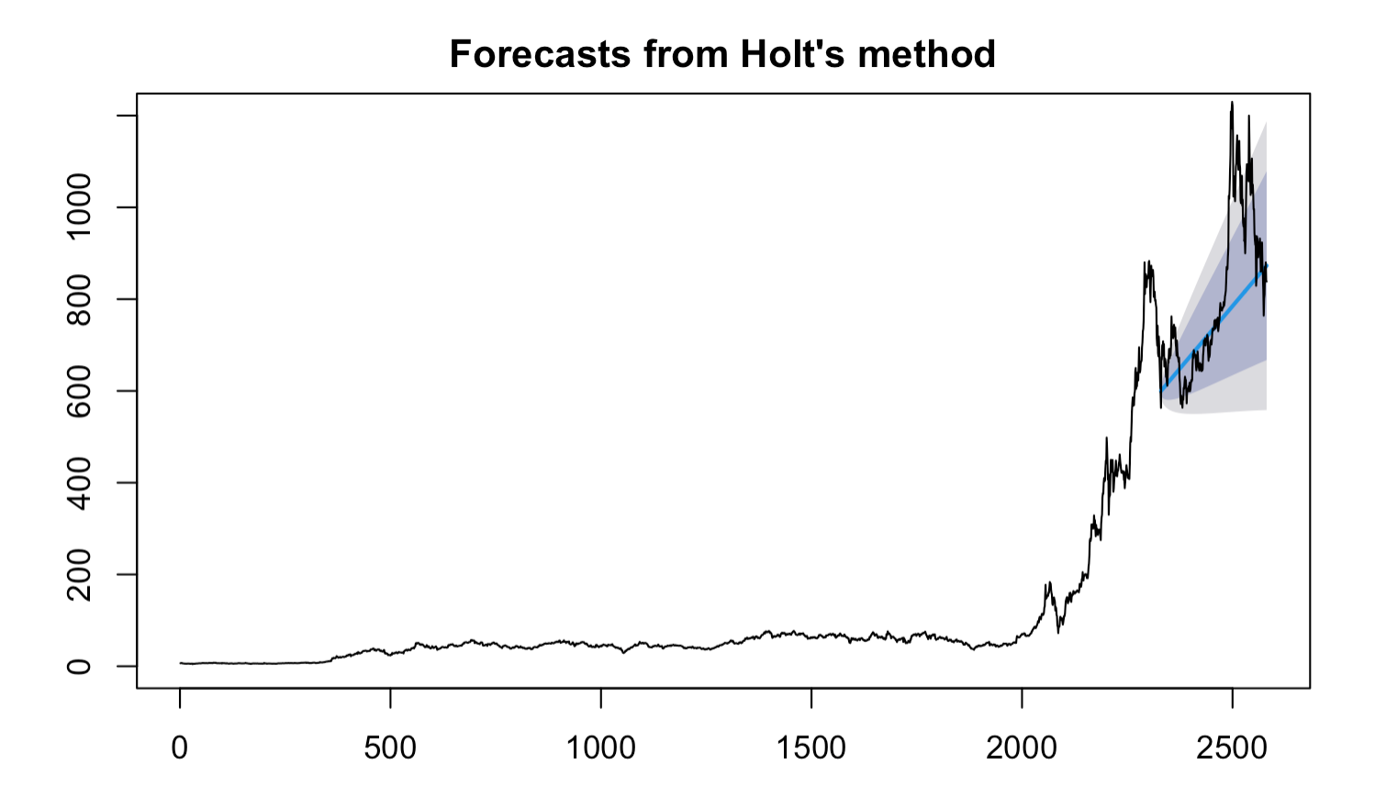
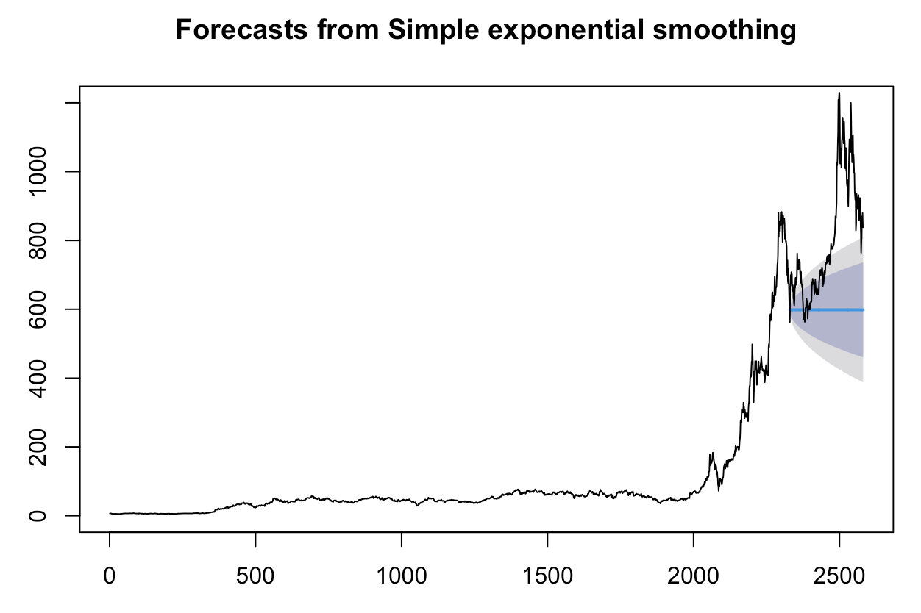
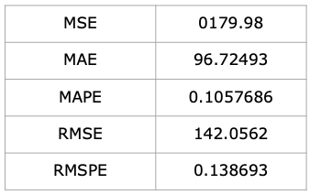
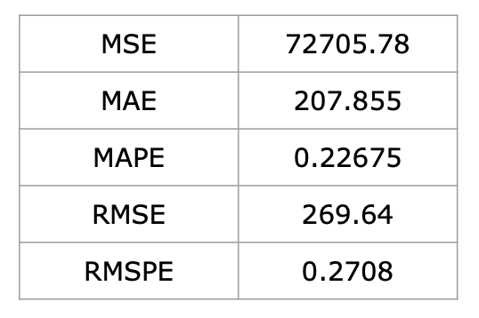
Introduction
EDA
Modeling & Results
Recommendation
Exponential Smoothing (SES) & Holt’s Trend
Tesla, Inc. | 11
Notes:
This is an extension of the simple exponential smoothing method which considers the trend component while generating forecasts. This method involves two smoothing equations, one for the level and one for the trend component.

Slide 14
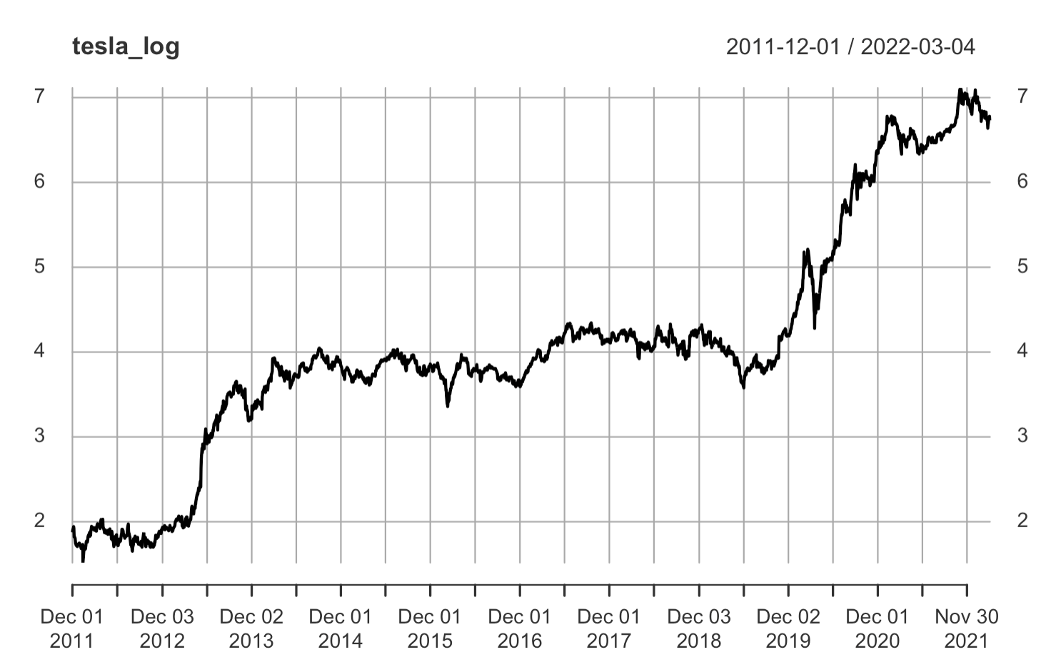
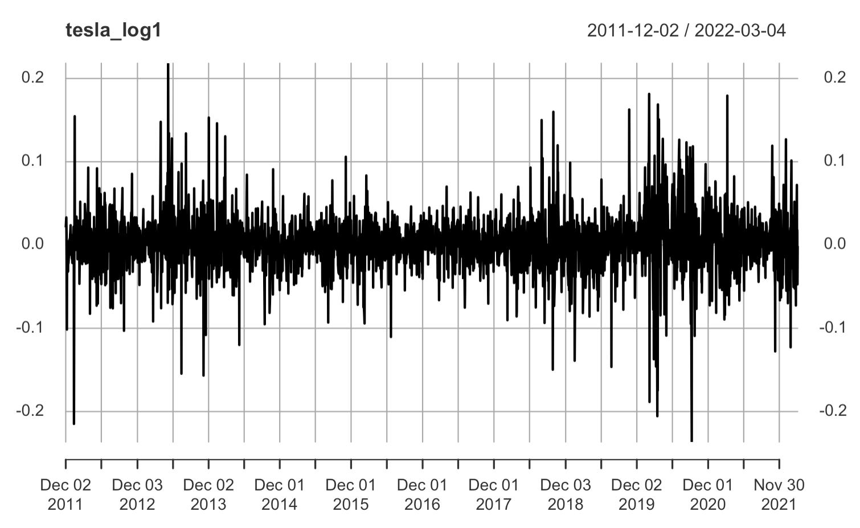
Introduction
EDA
Modeling & Results
Recommendation
GARCH Model
Tesla, Inc. | 14
Notes:
takes into account the volatility to help predict what the next value will be for the time series.

Slide 15
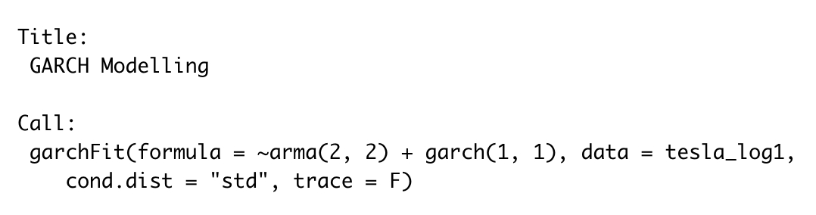
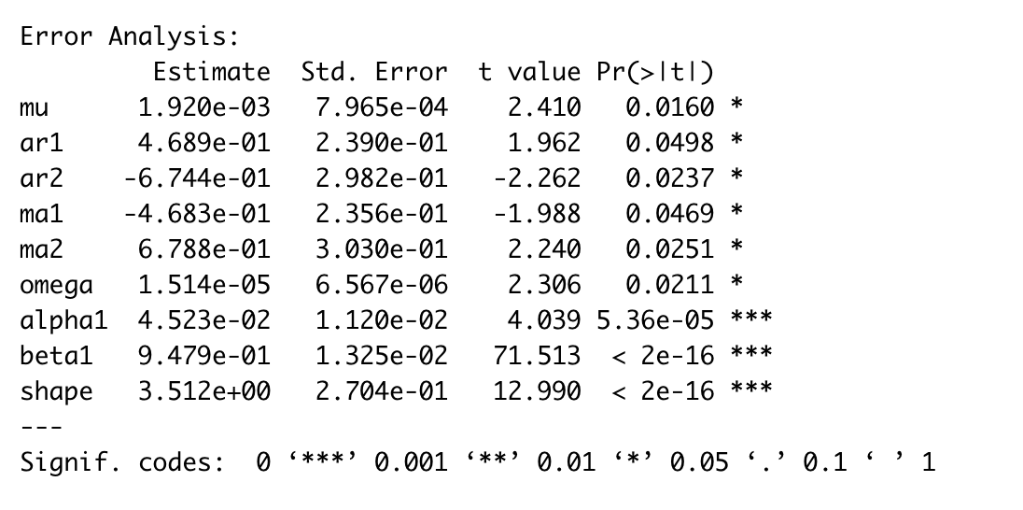
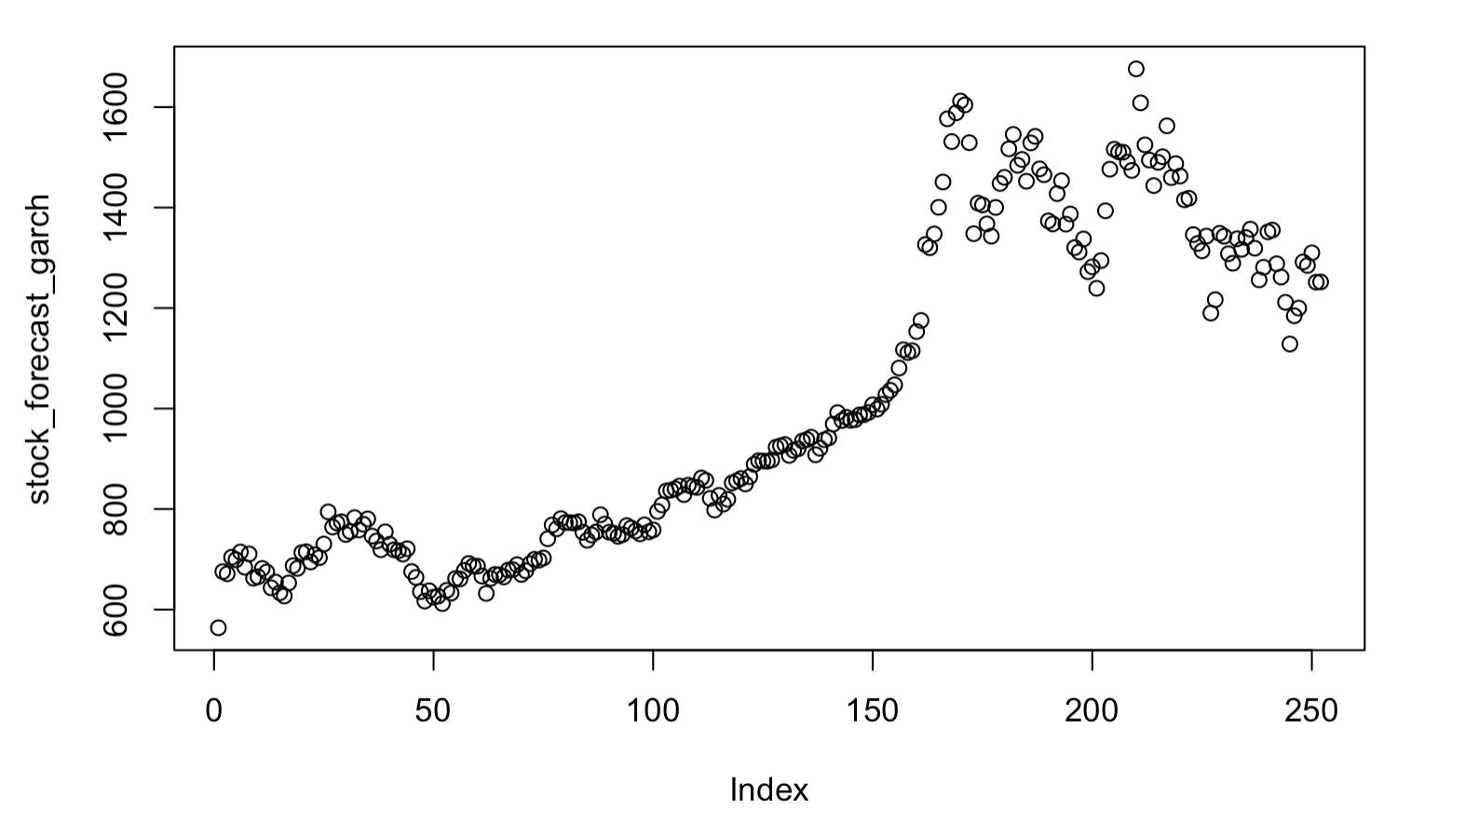
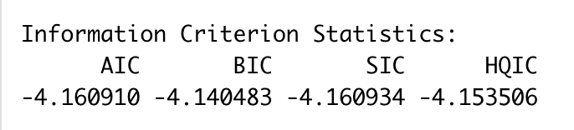
Introduction
EDA
Modeling & Results
Recommendation
GARCH Model Cont’d
•From Ljung-Box test, p-value is greater than 0.05. Residuals are independently distributed.
Tesla, Inc. | 13
Notes:
Model: Garch

Slide 16
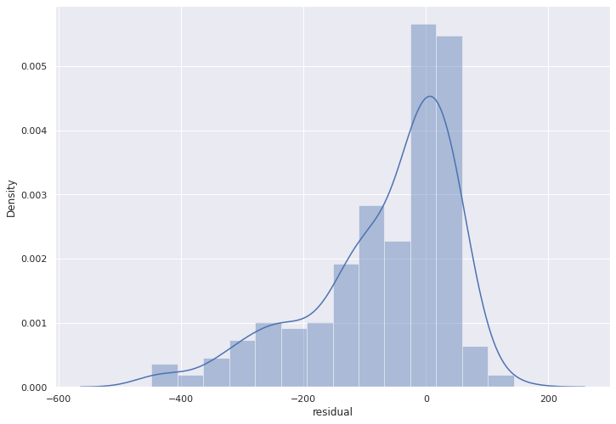
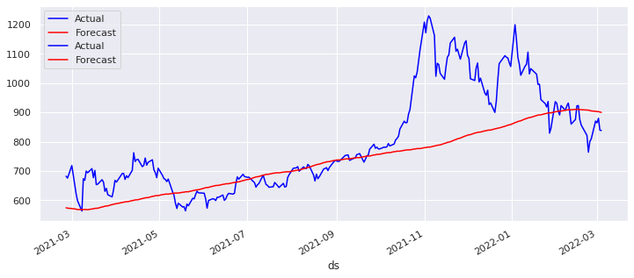
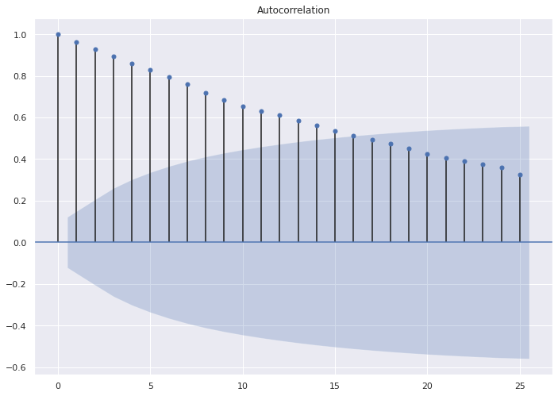

Introduction
EDA
Modeling & Results
Recommendation
Prophet Curve Fitting
MAPE | 0.102
RMSE | 135.39
Tesla, Inc. | 13
Notes:
Model is biased to underestimate the price
the ACF dying down slowly for a non-stationary time series

Slide 17



Introduction
EDA
Modeling & Results
Recommendation
Multivariate Stock Price Forecasting
Elon Musk Twitter Sentiment
NYT Tesla Headlines Sentiment
Tesla, Inc. | 14
Notes:
Model:

Slide 18
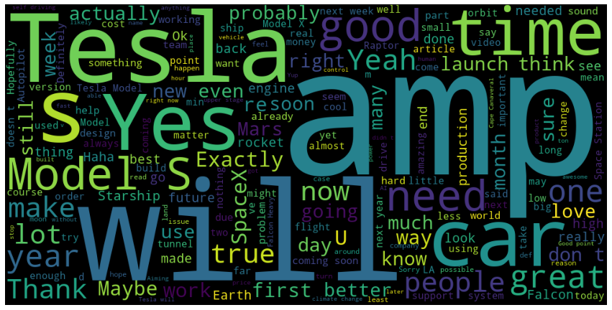
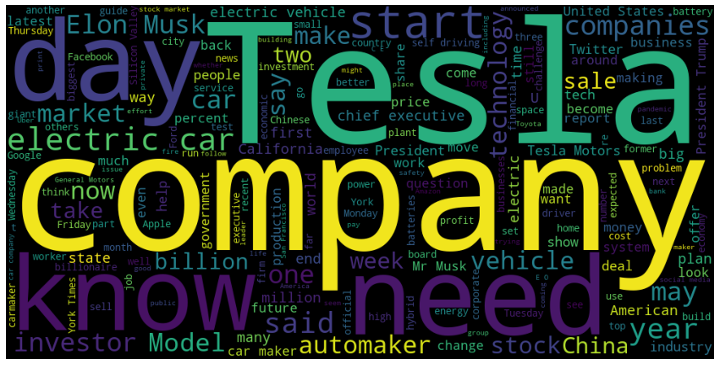
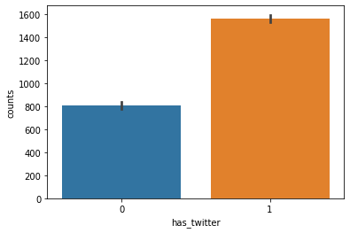
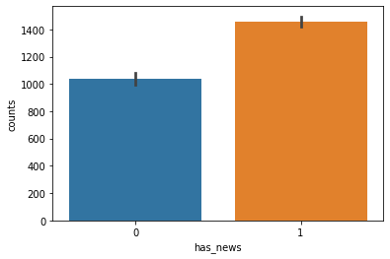
Introduction
EDA
Modeling & Results
Recommendation
EDA on Text Features
Twitter WordCloud
News WordCloud
Tesla, Inc. | 14
Notes:
Model:

Slide 19
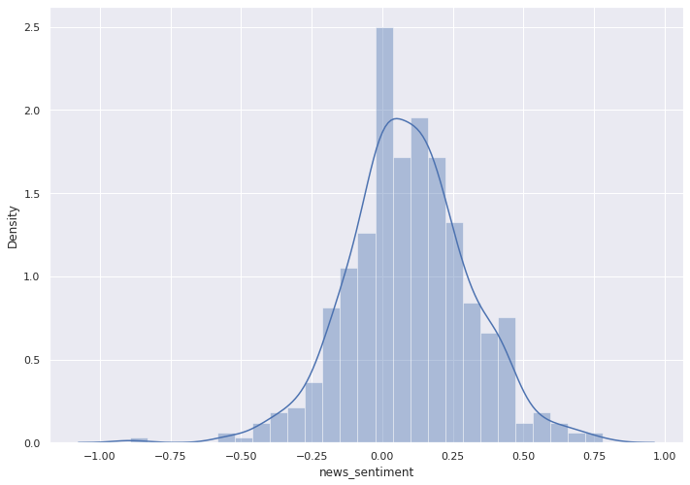
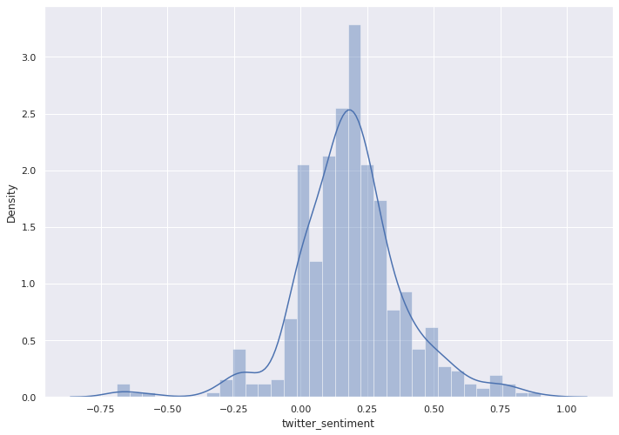
Introduction
EDA
Modeling & Results
Recommendation
EDA on Text Features
Tesla, Inc. | 14
Notes:
Model:

Slide 20
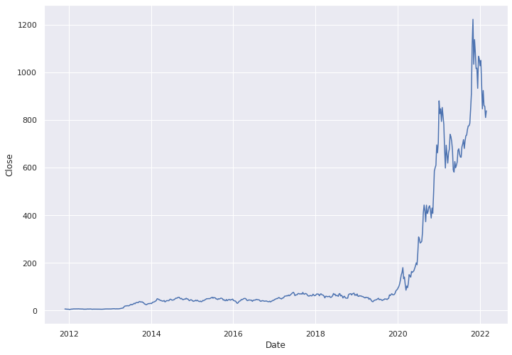
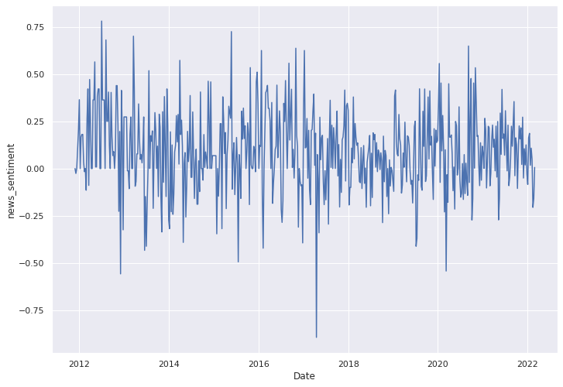
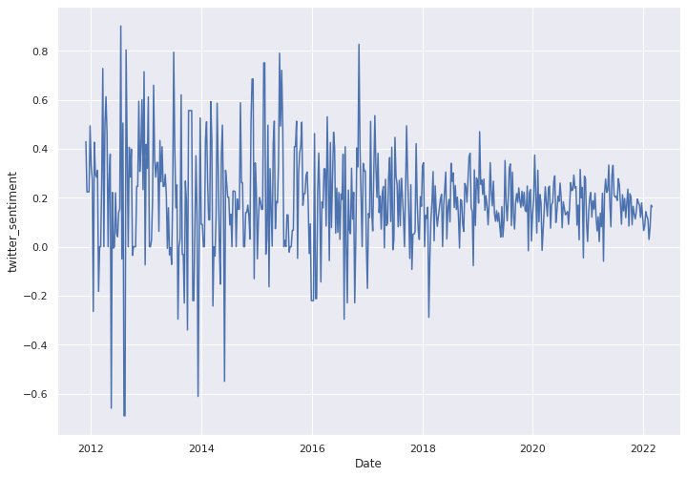
Introduction
EDA
Modeling & Results
Recommendation
Data Transformation
Transform Daily to Weekly
- Downsampling
Weekly Tesla Closing Price
Weekly average news sentiment score
Weekly average twitter sentiment score
Downsampling reduced the percentage of missing values to 6% for news sentiment scores and 4% for twitter sentiment scores. The values were interpolated using backfill method
Tesla, Inc. | 15
Notes:
Model:

Slide 21
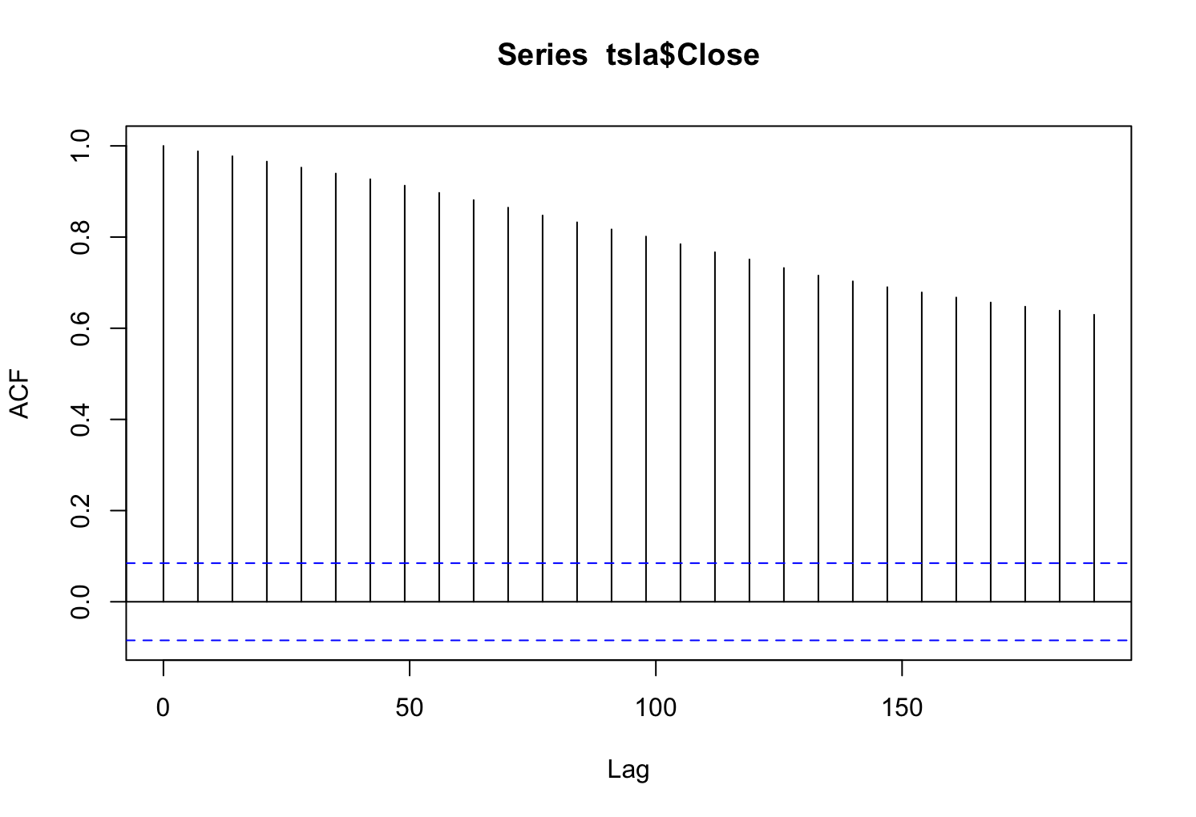
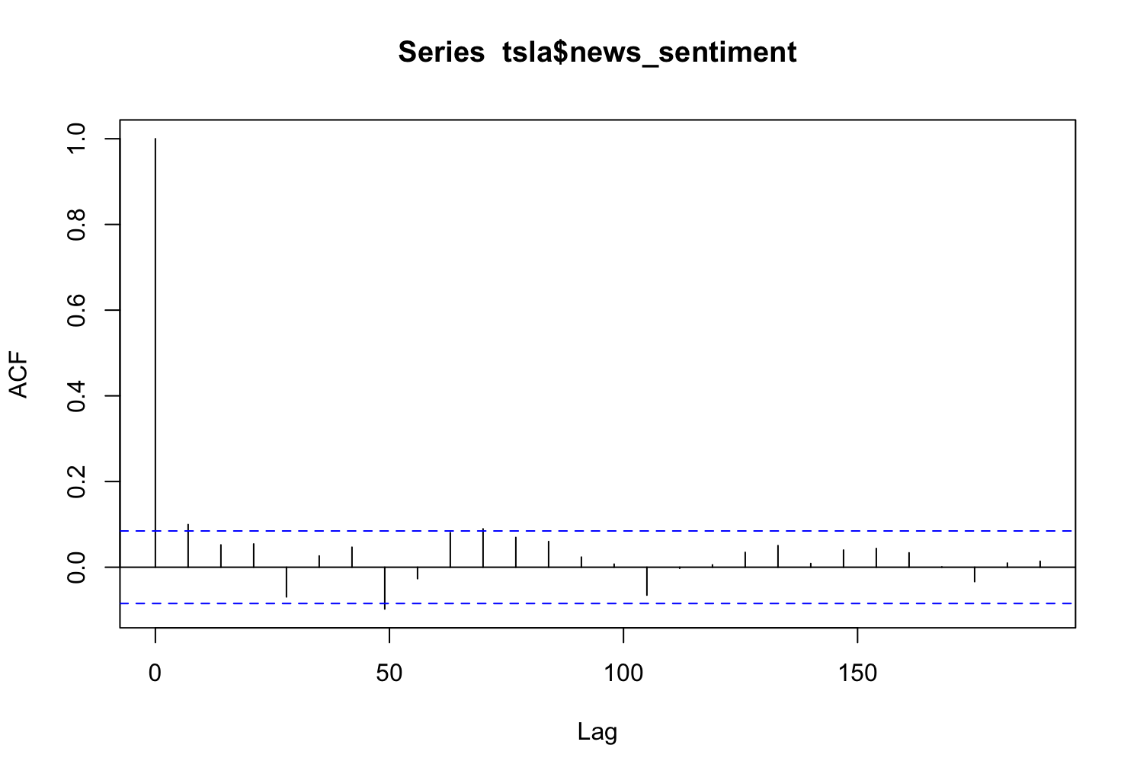
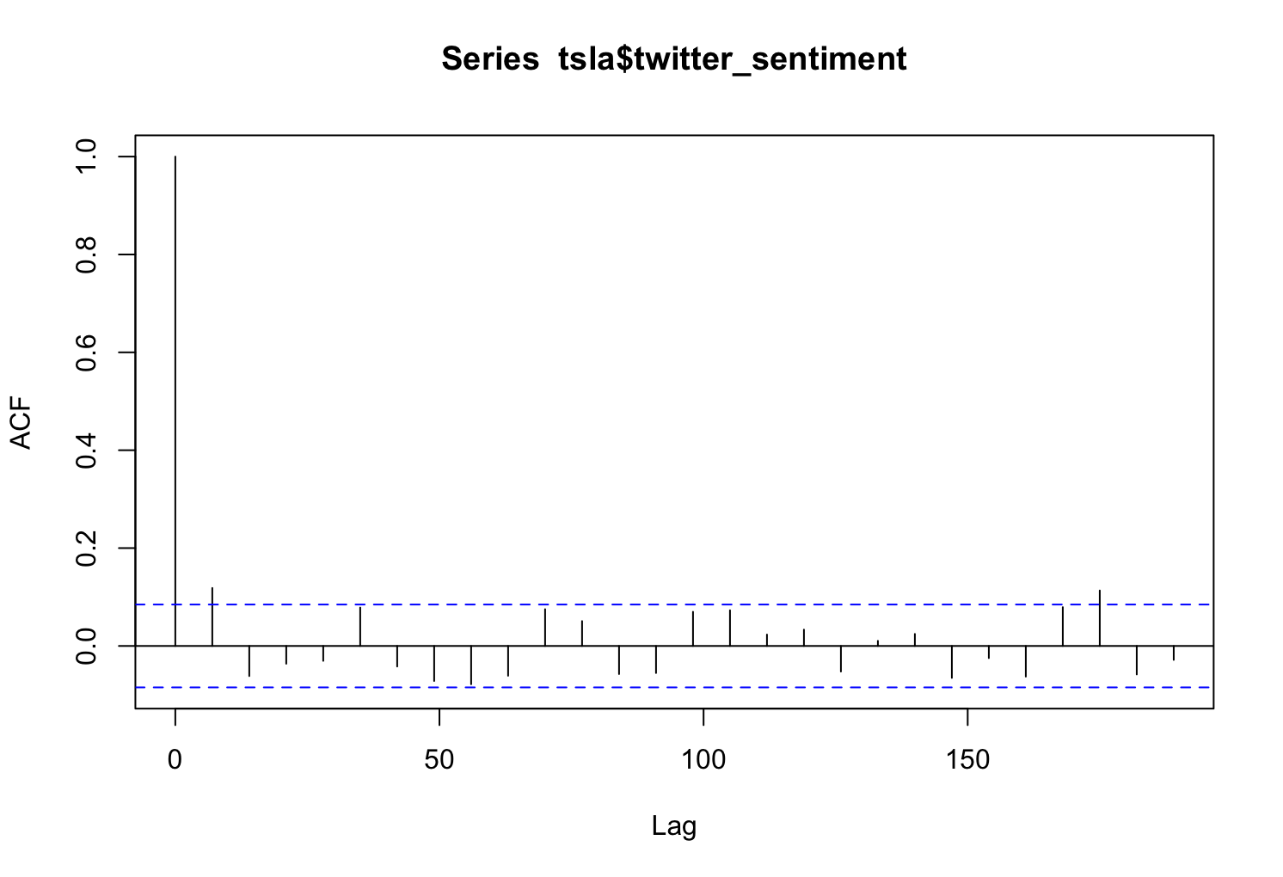
Introduction
EDA
Modeling & Results
Recommendation
ACF
Tesla, Inc. | 15
Notes:
Model:

Slide 22






Introduction
EDA
Modeling & Results
Recommendation
ADF & KPSS Test
Tesla, Inc. | 15
Notes:
Model:

Slide 23



Introduction
EDA
Modeling & Results
Recommendation
Prophet Curve Fitting Model
MAPE | 0.15
RMSE | 173.86
Tesla, Inc. | 15
Notes:
Model:

Slide 24
Introduction
EDA
Modeling & Results
Recommendation
Results Comparison
Univariate Models
 | Naïve | Exp. S (ETS) | Holt’s Trend | Prophet
MAPE | 2.52% | 2.51% | 10.57% | 10.25%
RMSE | 30.98 | 31.05 | 142.06 | 135.39
Multivariate Model
 | Prophet
MAPE | 15%
RMSE | 173.86
Tesla, Inc. | 14
Notes:
Model:

Slide 25
Introduction
EDA
Modeling & Results
Recommendation
Future Improvements/ Next steps
Explore other features of text data, such as intent to predict stock price
Combine with Technical analysis indicators to strengthen model
Tune model parameters to achieve better results
Tesla, Inc. | 16

Slide 26



